Slide 1

Facial Recognition Attendance System
Streamline Attendance Management
Team Members
Satyam Yadav
Vishista Patel
Nandlal Yadav
Shivang Gupta

Slide 2
The Problem: Time Consuming & Error-Prone
Manual Attendance
Our Solution
Time consuming, prone to errors, and vulnerable to fraud.
Automated facial recognition for accurate and efficient attendance tracking.

Slide 3

Key Features: Simplicity and Accuracy
1
Registration
2
Attendance Marking
Capture student faces for database.
Real-time facial recognition to mark attendance.
3
Data Logging
4
Attendance Viewer
Time-stamped attendance
records stored in a CSV file.
View logged attendance in
table form.
5
Exporting
Can export attendance file for further processing.

Slide 4




Workflow: Seamless and Efficient
1. Register
Capture and save student photos
2. Mark Attendance
Match faces against registered database.
3. Log Data
Record attendance details in CSV file.

Slide 5





Tools & Technologies: Robust and Powerful
Python
Tkinter
Programming language for system development.
GUI library for creating user interface.
OpenCV
Face Recognition
Csv Module
Library for image processing and capturing.
Library for facial recognition algorithms.
For logging attendance in CSV file.

Slide 6

Benefits: Efficiency, Accuracy, Security
Efficiency
Accuracy
Saves time and eliminates manual data entry
Eliminates proxy attendance and ensures accurate records.
Security
Provides reliable identification and reduces the risk of unauthorized access.

Slide 7
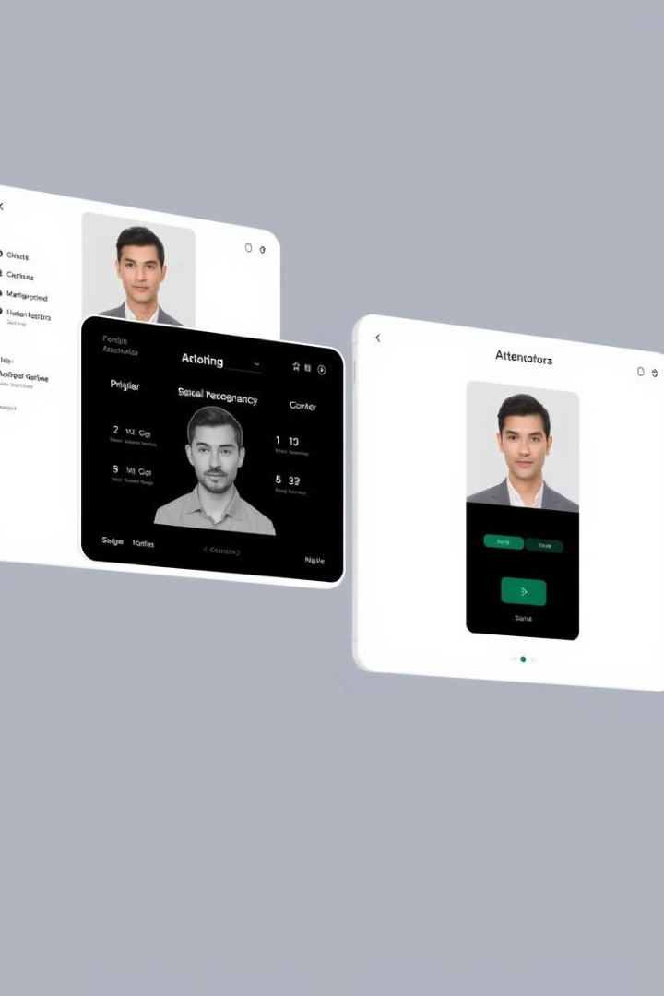
Future Development: Enhanced User Experience
Integration of advanced features for a more robust and user-friendly experience.

Slide 8
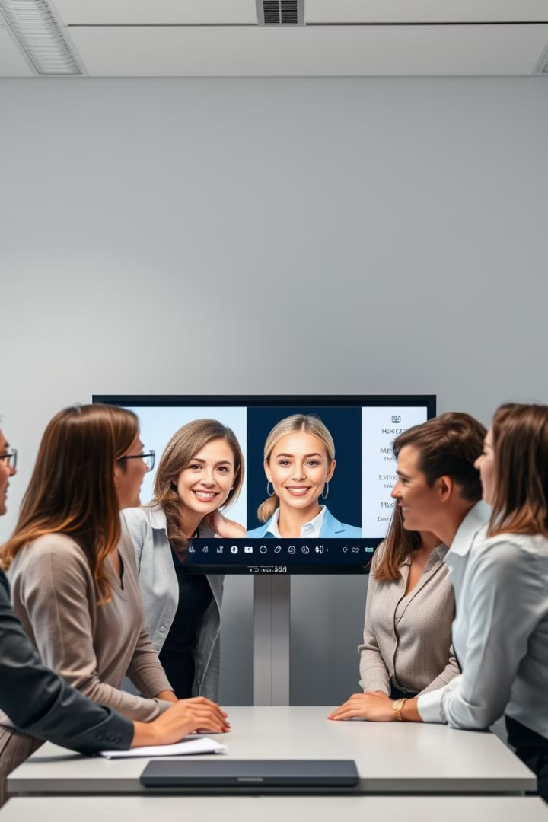
Conclusion: A Modern Solution for Attendance
This facial recognition system offers a simple, effective, and secure approach to managing attendance, saving time and resources.

